Slide 1

 | BMS INSTITUTE OF TECHNOLOGY & MANAGEMENT, YELAHANKA, BANGALORE. Department of Computer Science & Engineering
Pressure Ulcer Prediction and Prevention
STUDENTS NAMES
A Nitya Dyuthi 1BY18CS001
Khushwinder Singh 1BY18CS074
Likith S 1BY18CS081
Prakhyat 1BY18CS108
UNDER THE GUIDANCE OF:
Mrs. Durga Bhavani A
Assistant Professor, CSE
BMSIT&M
2021-22

Slide 2
CONTENTS
Abstract
Introduction
Problem Statement
Objective
Literature Survey
Limitations of Existing Systems
Research Gap and Research Challenges
Proposed Methodology
Expected outcomes
References

Slide 3
Abstract
Decubitus ulcer (bedsores or pressure ulcers) are a common injury that mainly plagues elders and frail persons, and is a major cause of concern in medical institutions.
Current screening and prevention techniques for assessing risk for decubitus ulcer formation and repositioning patients every 1-2 hours are labor-intensive and can be subjective.
We have proposed a system using low-cost, disposable wireless, and unobtrusive fabric-based pressure sensors and other sensors to continuously monitor the tissue status in at-risk areas to detect the pressure and make the necessary adjustments to the bed to prevent the same.

Slide 4
Abstract
What is an ulcer?
What is a pressure ulcer?
How many people are bed ridden currently?
We have proposed a system using low-cost, disposable wireless, and unobtrusive fabric-based pressure sensors and other sensors to continuously monitor the tissue status in at-risk areas to detect the pressure and make the necessary adjustments to the bed to prevent the same.

Slide 5
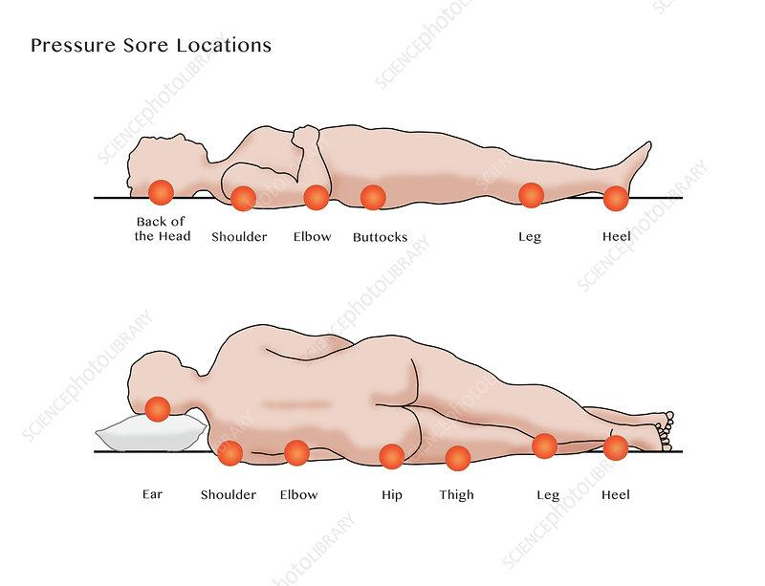
Introduction
Elders, whether they are staying at home, hospitals, or retirement homes, often incur the risk of health symptoms and problems. In many cases, some form of monitoring is helpful to help the healthcare personnel prevent the degradation of the patient’s health status.
Decubitus ulcers (DU), also called bedsores or pressure ulcers, are wounds that develop when the skin undergoes constant pressure for a prolonged time. Due to the bony prominence, the common sites for DU include heels, shoulder blades, elbow, and coccyx/sacrum (gluteal).

Slide 6
Problem Statement
Bedsores are dangerous and can have important consequences, leading to long-term hospitalization. At more severe stages, bedsores become very painful, the patient is at risk of surgery and even of death. Prevention techniques in hospitals and retirement homes today are still traditional, where the person spends a considerable amount of time regularly checking the status of their patients and their changes in body position.

Slide 7
Objective
In the proposed system, data is gathered from many ambient pressure sensors from the individual cells of the grids to evaluate the risk areas depending on the total time of impact.

Slide 8
Literature Survey
Multiple decubitus ulcer risk assessment tools are used worldwide with the most popular being the Braden, Norton, and Waterlow scales.
The Braden scale is most popular and involves a 1 to 6 ranking of a patient’s sensory perception, moisture, activity, mobility, nutrition, and friction and shear to generate a composite risk score.
While quantitative, scoring can be subjective and studies have shown high variability in scoring between clinicians.

Slide 9
Limitations of Existing Systems
The current prediction of a pressure ulcer occurrence is using the Braden Scale approach or Waterloo Scale approach, which requires a lot of human interference and often takes up a lot of attention from the caretakers, which prevents them from serving the actual purpose.
Based on studies conducted, it can be inferred that such mattresses can be effective only up to an extent and is not always effective.
There is a high chance for the formation of pressure ulcers even after utilizing such mattresses.

Slide 10
Research Gap and Research Challenges
Body pressure dispersion mattresses are useful tools for preventing pressure ulcers. Pressure-reducing mattresses redistribute a patient's weight so as to relieve pressure points. Static mattresses deliver pressure relief through the use of high-quality foam.
Combinations of foam are utilized and some are castellated to further reduce shear and friction. Generally speaking, CME foam mattresses are suitable for those up to the medium risk of developing a pressure ulcer. Visco mattresses are suitable up to high risk or very high risk.

Slide 11
Proposed Methodology
The proposed system includes a prediction of the formation of pressure ulcers and then applies reasonable methods to prevent the same.
The prediction of the pressure ulcer can be automated by using an array of sensors primarily pressure sensors and automating the entire process thereby letting caretakers focus on the primary requirement.
The prevention system involves making necessary adjustments so as to reduce human interventions furthermore and therefore completely eliminate the need for human intervention.

Slide 12
Expected outcomes
The problem can be solved by using an IoT-based approach by utilizing different sensors for prediction and motors for prevention. It involves using a low-cost approach thereby reducing costs and making it affordable for everyone.

Slide 13
References
[1]Sam Mansfield.,Eric Vin.,Katia Obraczka(2021). An IoT System for Autonomous, Continuous, Real-Time Patient Monitoring and Its Application to Pressure Injury Management. doi:10.1109/ICDH52753.2021.00021
[2]Zijun Cao.,Fang Wang., Yaoguang He., Yu Zhang., Jianguo Zhang (2021). Analysis of plantar pressure in elderly diabetic patients with peripheral neuropathy. doi:10.1109/ICPHDS53608.2021.00044
[3]Bilge Yilmaz., Ercan Atagün., Fadime ÖĞÜLMÜŞ Demırcan., İbrahim Yücedağ(2021). Classification of Pressure Ulcer Images with Logistic Regression. doi:10.1109/INISTA52262.2021.9548585
[4]Therdpong Daengsi.,Bundit Muttisan., Pongpisit Wuttidittachotti., Patsita ., Sirawongphatsara (2021). Sustainable Development of a Prototype of Air Mattress from Re-Used Materials for Pressure Ulcer Prevention. doi:10.1109/GECOST52368.2021.9538773
[5]Malindu Ehelagastenna., Ishan Sumanasekara., Hishan Wickramasinghe., Indrajith D. Nissanka., Gayani K. Nandasiri(2021).Design of an Alternating Pressure Overlay for the Treatment of Pressure Ulcers. doi:10.1109/MERCon52712.2021.9525787

Slide 14
[6] Isabel Morales.,Rafael González-Landaeta.,Franco Simini(2021)Pressure sensors used as bioimpedance plantar electrodes: a feasibility study. doi:10.1109/MeMeA52024.2021.9478682
[7]Eman Elsharif., Nabil Drawil., Salaheddine Kanoun(2021)Automatic Posture and Limb Detection for Pressure Ulcer Risk Assessment. doi: 10.1109/MI-STA52233.2021.9464360
[8]Zeinab Shayan., Mohammad Sabouri., Milad Shayan., Mohammad Hassan Asemani., Ali Bina Sarmoori., Mohammad Zare(2021). Pressure control of cellular electromechanical medical mattress for bedsore prevention. doi: 10.1109/ICCIA52082.2021.9403585
[9]Eun-Bin Park.,Jin-Chul Heo., Chanil Kim., Beomjoon Kim., Kwangyeol Yoon., Jong-Ha Lee(2020).Development of a Patch-Type Sensor for Skin Using Laser Irradiation Based on Tissue Impedance for Diagnosis and Treatment of Pressure Ulcer. doi: 10.1109/ACCESS.2020.3048242
[10] Kottner, J., Cuddigan, J., Carville, K., Balzer, K., Berlowitz, D., Law, S., … Haesler, E. (2020). Pressure ulcer/injury classification today: An international perspective. Journal of Tissue Viability. doi:10.1016/j.jtv.2020.04.003
[11]Xuanchen Ji., Yasuhiro Akiyarna., Yoji Yamada., Shogo Okamoto., Hisae Hayash(2020).Development of deep clustering model to stratify occurrence risk of diabetic foot ulcers based on foot pressure patterns and clinical indices. doi:10.1109/IJCB48548.2020.9304917
[12]Brecht Serraes,Martin van Leen,Jos Schols,Ann Van Hecke,Sofie Verhaeghe,Dimitri Beeckman(2018). Prevention of pressure ulcers with a static air support surface: A systematic review. doi.org/10.1111/iwj.12870

Slide 15
Thank You!

